Slide 1
Getting started with Machine Learning
CIS662, Sep. 6, 2023

Slide 2
Class Exercise
Task: to predict how much rain is expected tomorrow in Syracuse.
How would we address this task without knowing anything about Machine Learning?

Slide 3
Class Exercise
Task: to predict how much rain is expected tomorrow in Syracuse.
How would we address this task with Machine Learning?

Slide 4
Reality
Processes generate data!
Some processes are deterministic; most are not.
Some processes involve the actions of autonomous agents.
Some contain feedback loops, so that outputs depend on old inputs, recent outputs, and perhaps external reinforcement (reward).
Noise may be inherent or the result of measurement.
The nature of a process may change with time.
Notes:
Natural processes (referred to here as "systems") generate real data as outputs, using real external inputs, the prior history of the process itself, external constraints and conditions that may vary, sources of noise (relating to measurement as well as the process itself), and feedback from the environment regarding the recent input-output behavior of the system.

Slide 5
Possible goals of Machine Learning
Prediction (of outputs of the process, in response to new inputs)
Process simulation (developing a functional description)
Process understanding (how the real process works)
Notes:
From this perspective, Machine Learning has been stated to have one or more of the following goals: (a) prediction, (b) process identification, and (c) process understanding.

Slide 6
Prediction (in the generic sense, not just forecasting)
Given: a new input
Goal: estimate what the corresponding system output should be.
These estimations may happen over time, depending also on recent inputs that may not be new.

Slide 7
Prediction: Archeology examples
Scientists have newly excavated some bones, and pose questions such as:
Which group of bones belong to the same animal? (Grouping, clustering…)
To which species does a newly excavated bone belong? (Classification)
What is the probability that an excavated bone belongs to T. Rex?
What is the predicted length of the leg of the animal to which an excavated partial thigh bone belongs?
In which direction should we dig next to uncover more bones?

Slide 8
Prediction is not process simulation!
We may accept good estimates, even if the logic or the actual relationship between input and output variables remains unknown.
Example: in some ML approaches, multiple models are developed, possibly contradicting each other, and we rely on an overall prediction that aggregates the results of each of these models.
Predictions may be performed without constructing any models, e.g., in nearest neighbor approaches, we simply rely on the expectation that similar inputs produce similar outputs, without any pretense of learning why that happens.
Notes:
After a specific prediction has been generated, we may (post-hoc) try to construct an explanation ("why this prediction") by summarizing aspects of the models that contributed most to the final prediction of the ensemble; but this is not the same as describing the general functional relationship between inputs and outputs.

Slide 9
Process Simulation
Goal: construct a “model” (mapping from inputs to outputs) that provides good estimates in all cases that fall in the applicable domain of input data.
The model describes all the computations that need to be carried out to obtain a reasonable estimate of the system outputs, when given the inputs.
With modern ML systems, especially with deep learning, the model may be very complex, involving the successive composition of numerous component nonlinear functions, which may not be amenable to any short summary.
Notes:
The model is really just a description of all the computations that need to be carried out to obtain a reasonable estimate of the system outputs, when given the inputs to the system. With modern ML systems, especially with deep learning, such a description may be very complex, involving the successive composition of numerous component nonlinear functions, which may not be amenable to any short summary. At best, we may say that the behavior of the model does accurately simulate the natural process, and even say what may happen if one input variable is increased a little. But we don't really say why. In the sense of Greg Chaitin, "comprehension is compression": lack of a short description of the model indicates that we haven't really understood what's going on in the model (or the real system being simulated). The capabilities of most ML systems are restricted in this manner. As a consequence, the limitations of applicability of the learned model are also not understood, e.g., the model may behave counter-intuitively when the new inputs are substantially different from the old ones.

Slide 10
Process Simulation is not “Understanding”!
At best, the model does accurately simulate the natural process, and say what may happen if one input variable is increased a little.
But we don't really say why.
In the sense of Greg Chaitin, "comprehension is compression”!
Lack of a short description of the model indicates that we haven't understood what's going on.
The limitations of applicability of the learned model are also not understood, e.g., the model may behave counter-intuitively when the new inputs are substantially different from the old ones.

Slide 11
“Understanding” = being able to …?...

Slide 12
“Understanding” = being able to …
Identify “features” (combinations of input attributes)
Determine relative importance of attributes and features
Construct causal explanations that can be verified
Represent uncertainty associated with observations or inferences
Deduce the limitations of an approach or model
It is very difficult to know whether understanding has been achieved!

Slide 13
What shall we do in ML?
Most of the time, we begin with a specific class of models (e.g., feedforward neural networks with one hidden layer).
Each model has some ”parameters” (e.g., connection weights in the neural network).
Parameter values are often randomly initialized.
We use a “learning algorithm” to modify parameter values iteratively until: (a) results are satisfactory; or (b) results stop changing; or (c) computational resources are exceeded.

Slide 14
ML as a high-level meta-algorithm
Choose a class of models, based on past experience;
Initialize parameter values of one or more models;
While (results are unsatisfactory) and/or (results continue to change/improve over some number of iterations) and/or (number of iterations are not excessive), do:
Use the available data to modify model parameter values;
4. Interpret the resulting models (with updated parameter values).

Slide 15
ML is Data-Driven!
Knowledge required to solve (new) problems must come from data.
In some applications, experts can be queried (knowledge elicitation).
We often begin with a preconceived notion of what the knowledge model must look like.

Slide 16
ML is Data-Driven!
Knowledge required to solve (new) problems must come from data.
In some applications, experts can be queried (knowledge elicitation).
We often begin with a preconceived notion of what the knowledge model must look like.
If no rough notion is available, we hypothesize, based on other problems that we have solved before.

Slide 17
ML is Data-Driven!
Knowledge required to solve (new) problems must come from data.
In some applications, experts can be queried (knowledge elicitation).
We often begin with a preconceived notion of what the knowledge model must look like.
If no rough notion is available, we hypothesize, based on other problems that we have solved before.
Fine-tuning requires looking at available data.
If the result is unsatisfactory, we revise our model, sometimes drastically.
Machine learning must accommodate for these processes!

Slide 18
Models
Models approximate reality. (They may not “represent” reality!)
Examples of models:
Differential equations
Production rules
Hidden Markov models
Feedforward Neural Networks
Associative networks
Decision trees

Slide 19
Models
Models approximate reality …
…
Models can be tested against data.
Evaluation criteria depend on the problem.

Slide 20
Learning Algorithms
Learning algorithms use data to determine characteristics of the model architecture, and to modify model parameters.
Architecture learning examples:
How many layers and nodes in a feedforward neural network?
How many rules, and of what kind, in a production system?
Parameter learning examples:
Coefficients in an equation
Weights in a neural network

Slide 21
Class Exercise
Learning task: to predict how much rain is expected tomorrow.
Questions:
What data can be used?
What kind of model?
What details of the model architecture need to be determined?
What are the parameters to be learnt?

Slide 22
Class Exercise
Learning task: to predict how much rain is expected tomorrow.
Assume we have somehow accomplished learning.
How would we evaluate the result of learning?

Slide 23
Incremental vs. Local vs. Global Search
In learning, we need to find a vector (of model parameters) that optimizes some function of the training data (e.g., accuracy).
How?
Incremental construction algorithms
Local Search algorithms
Global Search algorithms

Slide 24
Incremental vs. Local vs. Global Search in Problem-Solving
In learning, we need to find a vector (of model parameters) that optimizes some function of the training data (e.g., accuracy).
How?
Incremental construction algorithms: start with an empty vector, keep adding components to it, making the best guess at each step, until you have a complete solution.
Example: Building a path from a source to a destination, at each step we decide on a move that will most likely move us in the right direction.

Slide 25
Incremental vs. Local vs. Global Search
In learning, we need to find a vector (of model parameters) that optimizes some function of the training data (e.g., accuracy).
How?
…
Local Search algorithms: start with a candidate solution, keep making small changes to it, until you are satisfied with the result.
Example: gradient descent
...

Slide 26
Local Search
While (… you are not exhausted or …) do:
Explore immediate neighborhood of current candidate solution, trying to find a better one.
Most learning algorithms fall into this simple paradigm!
Gradient Descent
Hill climbing
Greedy algorithms

Slide 27
Well-known problem with Local Search
If a function being optimized has multiple local optima, gradient descent (and hill-climbing, etc.) can only find the nearest one, and search stops well before reaching the best possible solution (global optimum).
This motivates other “global search” algorithms such as evolutionary algorithms and simulated annealing.

Slide 28
Incremental vs. Local vs. Global Search
In learning, we need to find a vector (of model parameters) that optimizes some function of the training data (e.g., accuracy).
How?
…
…
Global Search algorithms: explore multiple regions of the search space, e.g., by parallel multi-threaded local search, simulated annealing, or evolutionary algorithms.

Slide 29
Incremental vs. Local vs. Global Search
In learning, we need to find a vector (of model parameters) that optimizes some function of the training data (e.g., accuracy).
How?
Incremental construction algorithms: start with an empty vector, keep adding components to it, making the best guess at each step, until you have a complete solution.
Local Search algorithms: start with a candidate solution, keep making small changes to it, until you are satisfied with the result.
Global Search algorithms: explore multiple regions of the search space, e.g., by parallel multi-threaded local search, simulated annealing, or evolutionary algorithms.

Slide 30
Learning Approaches
Point-based (iteratively modifying one candidate solution)
Analogy: one doctor conducts new tests over time, steadily improving the reliability of her diagnosis about a patient.
Example: Backpropagation for neural networks
Ensemble (combining results from multiple models trained separately)
Analogy: ten doctors independently evaluate a patient, then all their opinions are combined, e.g., selecting the majority diagnosis.
Example: Random forests
Population-based (interacting experts)
Analogy: ten doctors sit together and discuss the patient’s case, revising their opinions by listening to others, until a consensus is reached
Example: Genetic algorithms

Slide 31
Need to choose models and learning algorithms
The same problem may be addressed using diﬀerent models!
E.g., a decision tree or a neural network may be used for a classification problem.
The same model’s parameter values can be estimated using diﬀerent learning algorithms.
E.g., backpropagation or evolutionary strategies may be used for training a neural network’s weights.

Slide 32
Domain-specific information is important!
For example, consider three short-term forecasting problems.
Finance: A company’s stock price is likely to be about the same tomorrow as today. (Why?)
Clothing: I am not likely to wear the same shirt on Thursday as Tuesday! (Why?)
Weather: If it rains today, it may rain tomorrow. (Why?)

Slide 33
Example problems from Finance
Classification (e.g., recognizing whether to give credit to a loan applicant)
Function approximation (e.g., deciding what interest rate to charge a loan applicant with a known risk profile)
Forecasting (e.g., predicting next year’s interest rates based on previous years’ interest rates and other financial/ fiscal/ political/ economic information)
Optimization (e.g., determining how much of different mutual funds to purchase in order to maximize returns based on a customer’s risk tolerance)

Slide 34
If you are evaluating a new algorithm or model, what is the “straw man” for comparison?
Classification: linear perceptron; support vector machine; small feedforward neural network trained with backpropagation; decision tree; random forest
Function approximation: linear regression; logistic regression; support vector regression; small feedforward NN (with backpropagation)
Forecasting/prediction over time: no change model; short-term average; long-term average; seasonal average; linear trend model; ARMA; ARIMA; LSTM/GRU neural network

Slide 35
How to show results
Most algorithms show fast improvements in early iterations and slow or sporadic improvements later. Logarithmic plots are better than linear plots.
Visual comparisons across two separate graphs are hard. Show multiple plots on the same graph, using different colors, dashed/dotted lines, etc.
The reader may not know what conclusion is to be drawn from a graph or table. State the conclusion clearly.
Tables with many numbers are hard to read. Avoid using too many digits; approximate instead (e.g., “12.1k” instead of “12,127.8149”).
Each trial with an algorithm may yield different results. Hence average across many trials (preferably 30), and also show standard deviations.
Sometimes extreme values skew the averages. The median is then more informative than the mean.

Slide 36
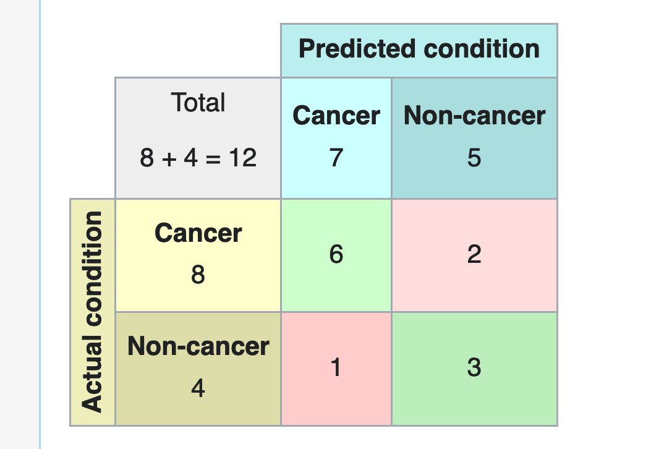


Example: how to show results
Accuracy
100%
75%
50%
1k 2k 4k 8k 16k 32k …
Number of updates (shown on log scale)
Training
Testing
Number of data points, in thousands, at the point when best test results are obtained

Slide 37
